Slide 1
FIN 342 PROJECT - Using Machine Learning to Predict Stock Returns in the Energy Sector
By Charles Yu

Slide 2


INTRODUCTION
Machine Learning and artificial intelligence provide ideal avenues to predict stock market prices and trends
Conduct evaluations on five frequently used ML models
Create a portfolio of twenty energy stocks that outperforms the benchmark performance

Slide 3

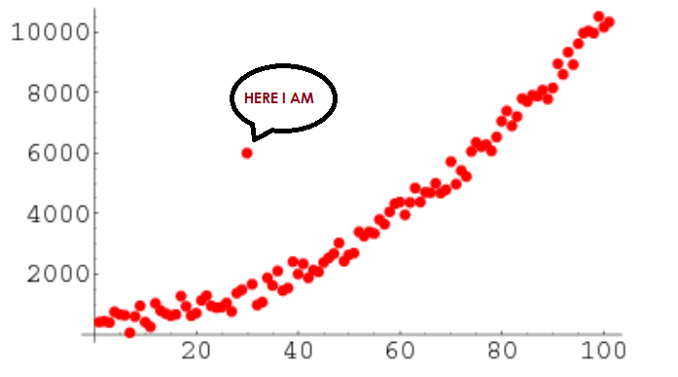

Exploratory Data Analysis
Exchange Rate
Political Instability
Remove Outliers
Added exchange rate data, relative to the strength of the U.S. Dollar, from five countries: Canada, Russia, Saudi Arabia, Iraq, and the United Arab Emirates
Political instability in oil-producing nations plays a critical role in stock price movements
Removing outliers would improve model predictions

Slide 4
Model Evaluations
Adjusted R-squared: how much variability can be explained in the model
Mean Square Error/Root Mean Square Error: absolute measure of fit
Mean Absolute Error: sums the absolute value of error
Notes:
Say this is from Gartner

Slide 5
Linear Regression
A linear regression “attempts to model the relationship between two variables by fitting a linear equation to observed data.”
Stock returns is considered the dependent variable, and other variables are considered the explanatory variables, such as return on equity, return on assets, the book to market value, etc.
The linear regression produced the highest out-of-sample validation R-Squared with a training set before 2016, a validation set from 2017 to 2019, and a test set of 2020

Slide 6
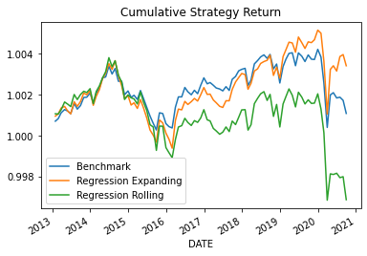

Slide 7
Select relevant features by setting coefficients to zero
The main objective of Lasso Regression is to shrink the coefficients to avoid overfitting and find the optimal variables that best predict stock returns in the energy sector
An important financial metric is called alpha, which measures the returns on investment
After trying different values for initialized alpha and the objective, I found that the best R-squared value is approximately 0.3%
Lasso Penalized Regression

Slide 8
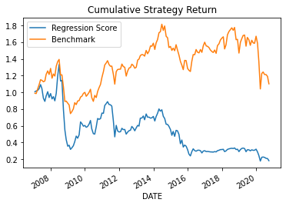

Slide 9
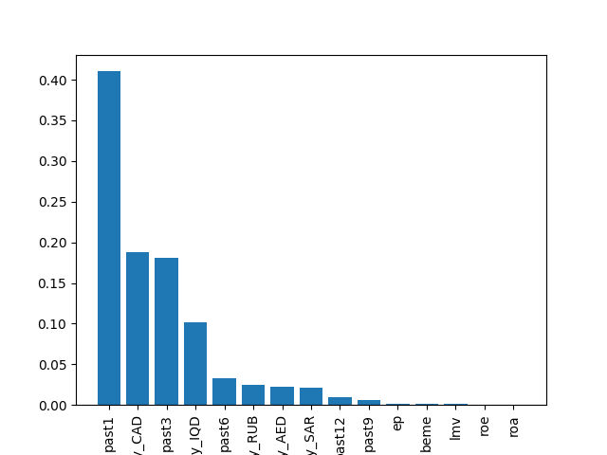
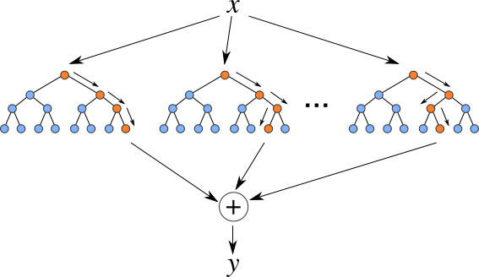
It aggregates the result of multiple trees
Typical used for non-linear dataset
Best Hyperparameters for Random Forest: {'max_depth': 3, 'max_features': 5, 'n_estimators': 100, 'random_state': 42}, Best Test-sample R-squared: -0.095, Best Validation-sample R-squared: 0.055
Random Forests

Slide 10
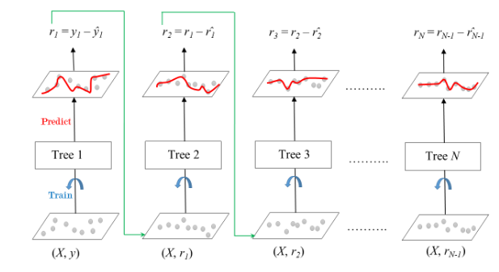
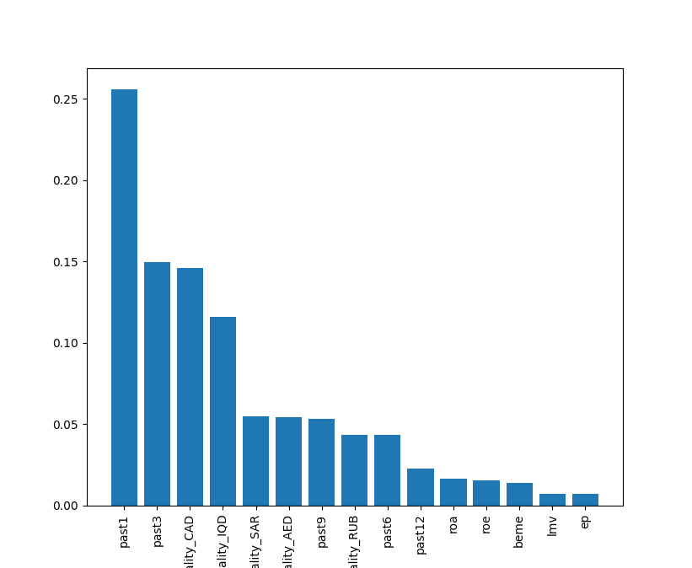
Generates a randomly generated number of trees
New trees are built off of the residuals, not randomness
Gradient Boosting Regression

Slide 11
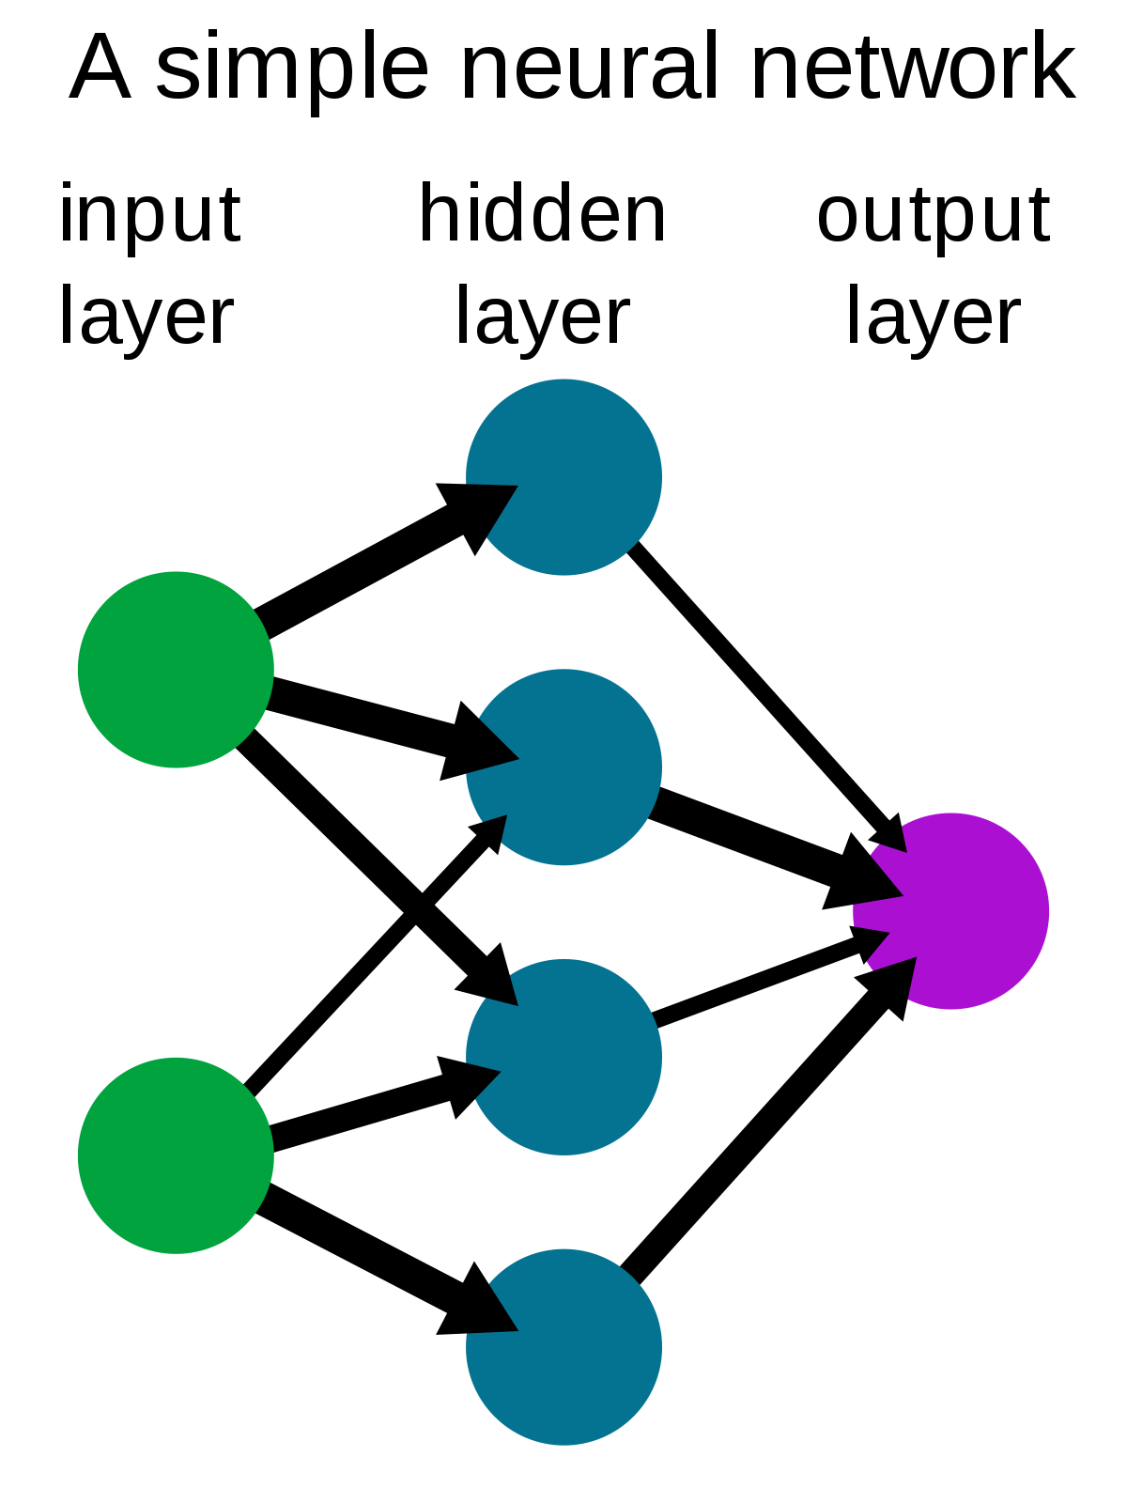
The ultimate “black box” of ML algorithms
Forward run, then backward propagation
Only 0.7% of the variability of smoothed returns is explained by the variables given
Overall, the usage of only dense neural networks is limited to predicting stock returns in the energy sector
Neural Networks

Slide 12
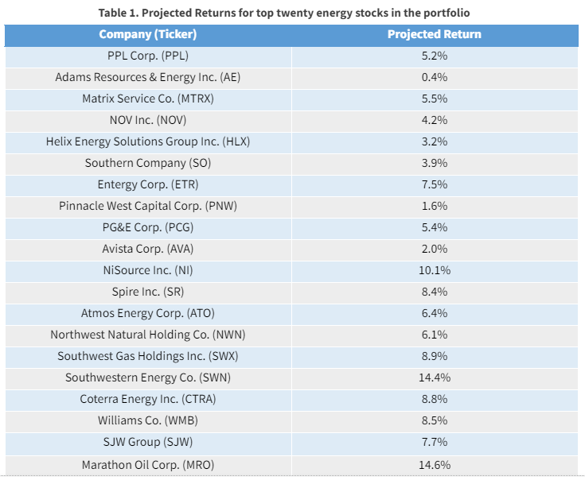
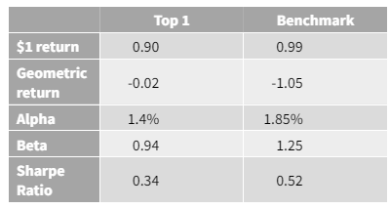
Results

Slide 13
THANKS
ANY QUESTIONS?

